Slide 1
Turning Tracy
Notes:
Hi, in this video we’re going to learn how to make Tracy turn so we can make more complex drawings.

Slide 2
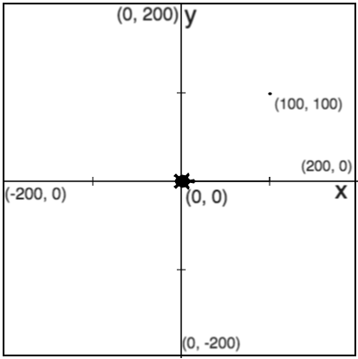
How do we make Tracy turn?
Tracy always starts facing right.
Notes:
We know that Tracy always starts at her home on coordinate (0,0). She also always starts facing right. We can use the (click for green box) forward and backward commands to move her, but what if we want Tracy to move (click for red boxes) to a location that is not on the x-axis? We need to be able to turn Tracy to face different directions so let’s take a look at the turning commands that Tracy knows.

Slide 3
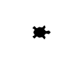


Tracy Command: left and right
left(90)
right(90)
Turns Tracy 90 degrees to the left
Turns Tracy 90 degrees to the right
left(90)
right(90)
Notes:
We have two commands that are specifically used to turn Tracy. These commands are ‘left’ and ‘right’. When we use these commands, we need to put ‘90’ into the parentheses.
Let’s take a look at how we can use these commands to write some programs.

Slide 4
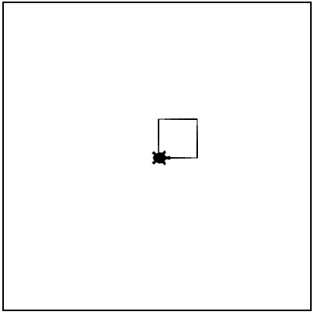
Example #1: Square
Write a program that has Tracy draw a square with sides of 50 pixels.
Notes:
In our first example, we are asked to draw a square with sides of length 50.

Slide 5
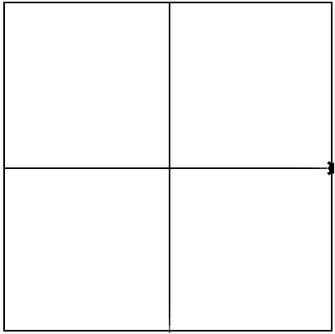
Example #2: X and Y Axes
Write a program that has Tracy draw an x- and y-axis on the canvas.
Notes:
In our second example, we want to draw the x- and y-axis on our canvas.

Slide 6
Commands Learned this Lesson
Command | What does it do?
left(90) | Turns Tracy 90 degrees to the left
right(90) | Turns Tracy 90 degrees to the right
Notes:
In this lesson, we learned how to turn Tracy using the left and right commands. Put all the commands you’ve learned so far together to solve the next coding exercises!

